Slide 2
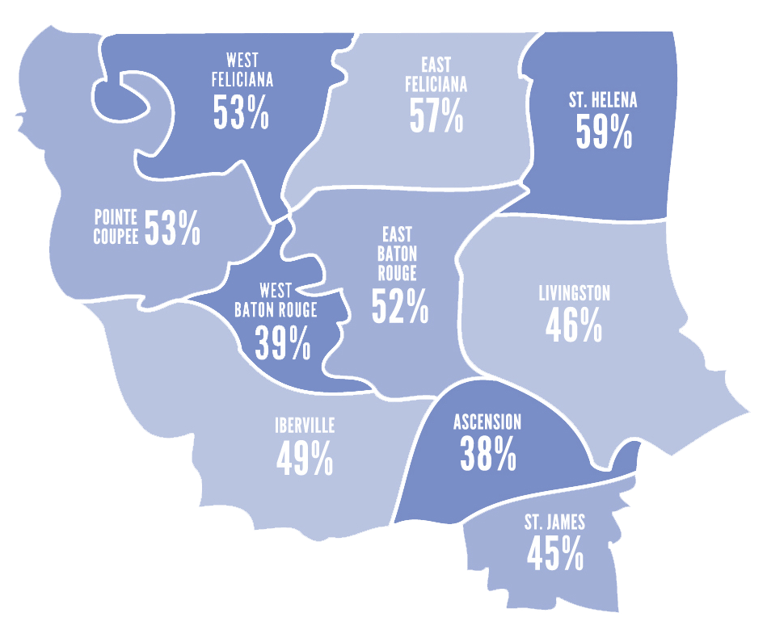
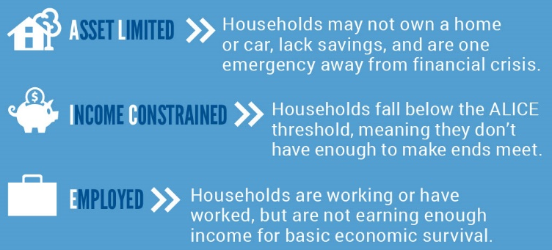
Who We Help: ALICE
The Capital Area
33%
ALICE 32%
Poverty 17%
Below ALICE Threshold 49%
Percentages reflect the average ALICE demographic across Capital Area United Way’s 10-Parish service area.
* Source: United Way ALICE Report 2020 update for Louisiana.
ALICE numbers pre COVID-19
Notes:
Change this slide to be the journey of ALICE from the brochure

Slide 3
How We Help: Programs & Initiatives
Bank On Baton Rouge
Focuses on three areas: assisting underserved populations with second chance bank accounts; promoting financial literacy education; and exploring FinTech (Financial Technology) programs.
United Way 211/CAUW
24/7 information, referral, crisis,
and disaster support services & Care Coordination
United4Vets Aims to coordinate, streamline, and provide wraparound services to veterans and their families.
Character Playbook
Online character development program for middle and high school students, in partnership with NFL Saints & Everfi
Volunteer Income Tax Assistance (VITA)
Free tax preparation for low to moderate income individuals and families
SingleCare Prescription
Discount Card
Providing community members with access to affordable prescription medications, ensuring greater health and financial stability
United We Feed Fresh produce distributions to the ALICE population

Slide 4
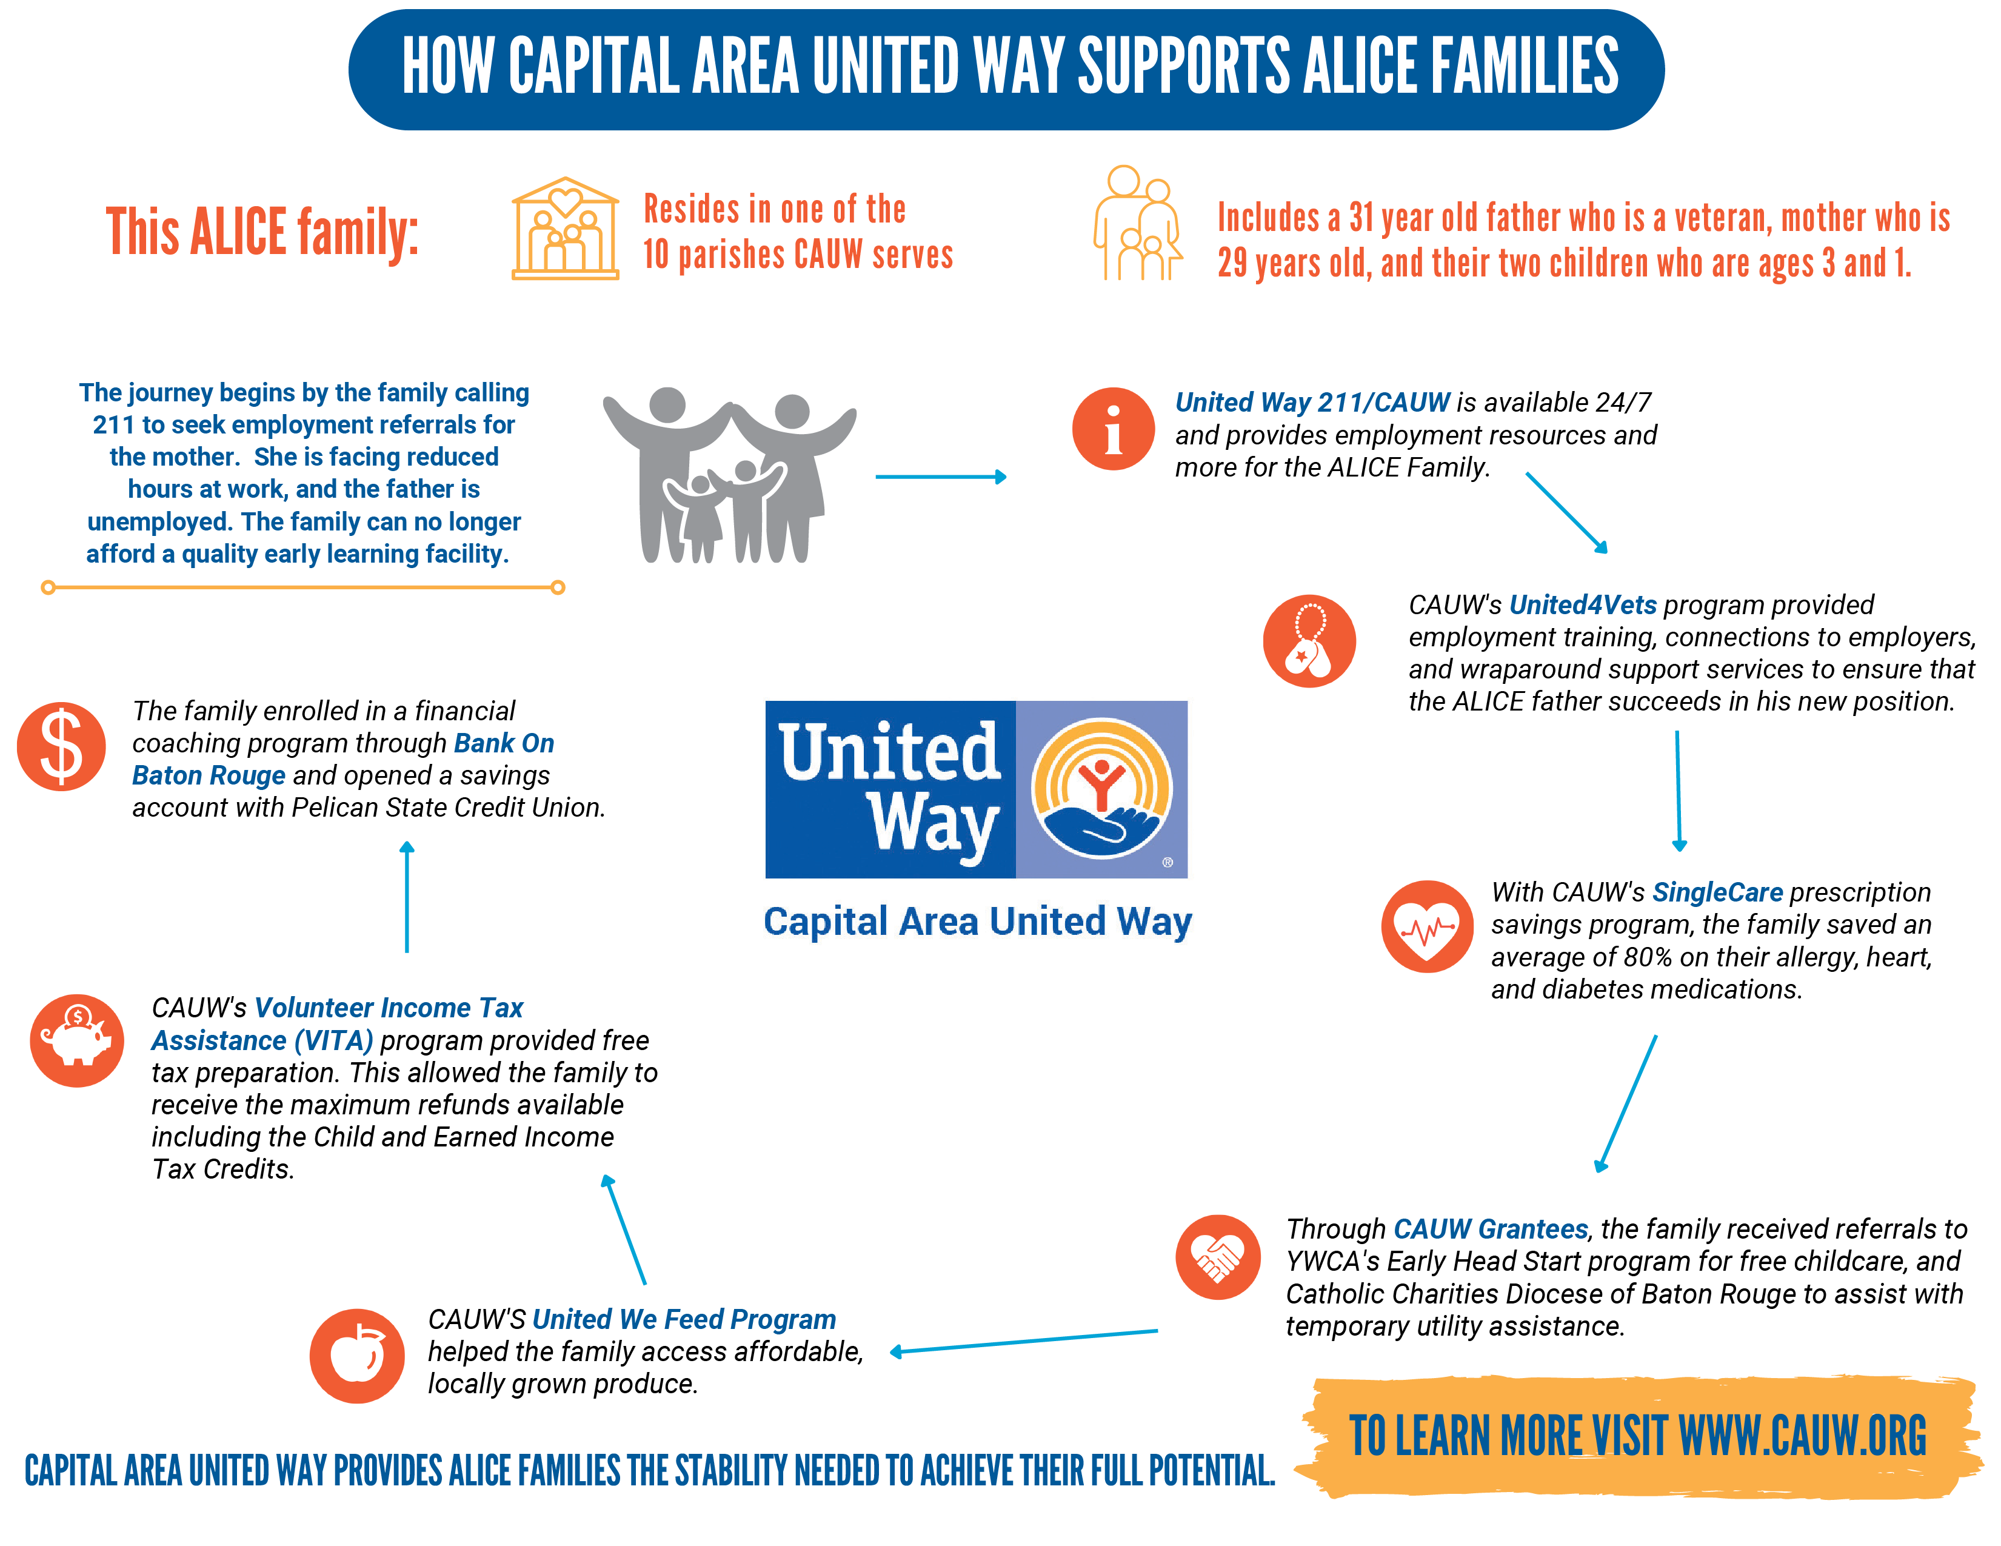

Slide 5
THANK YOU for allowing us to serve your community for 98 years!

